Slide 1
NJDR Database Solutions
HealthOne Medical Database

Slide 2

Our Team
Diane McNeely – Entity Specialist
Jamie Calderwood – Relationship Management and Normalization Strategist
Robert Lothian – Recursive Relationship and Arc Consultant
Neil Kirker – Historical Data and Data Mapping Guru

Slide 3
Your Business Needs
Track health claims
Keep detailed information on patients, doctors, visitations to doctors, drug prescriptions
Needs to be easily maintained and updated
Be able to be further expanded on

Slide 4
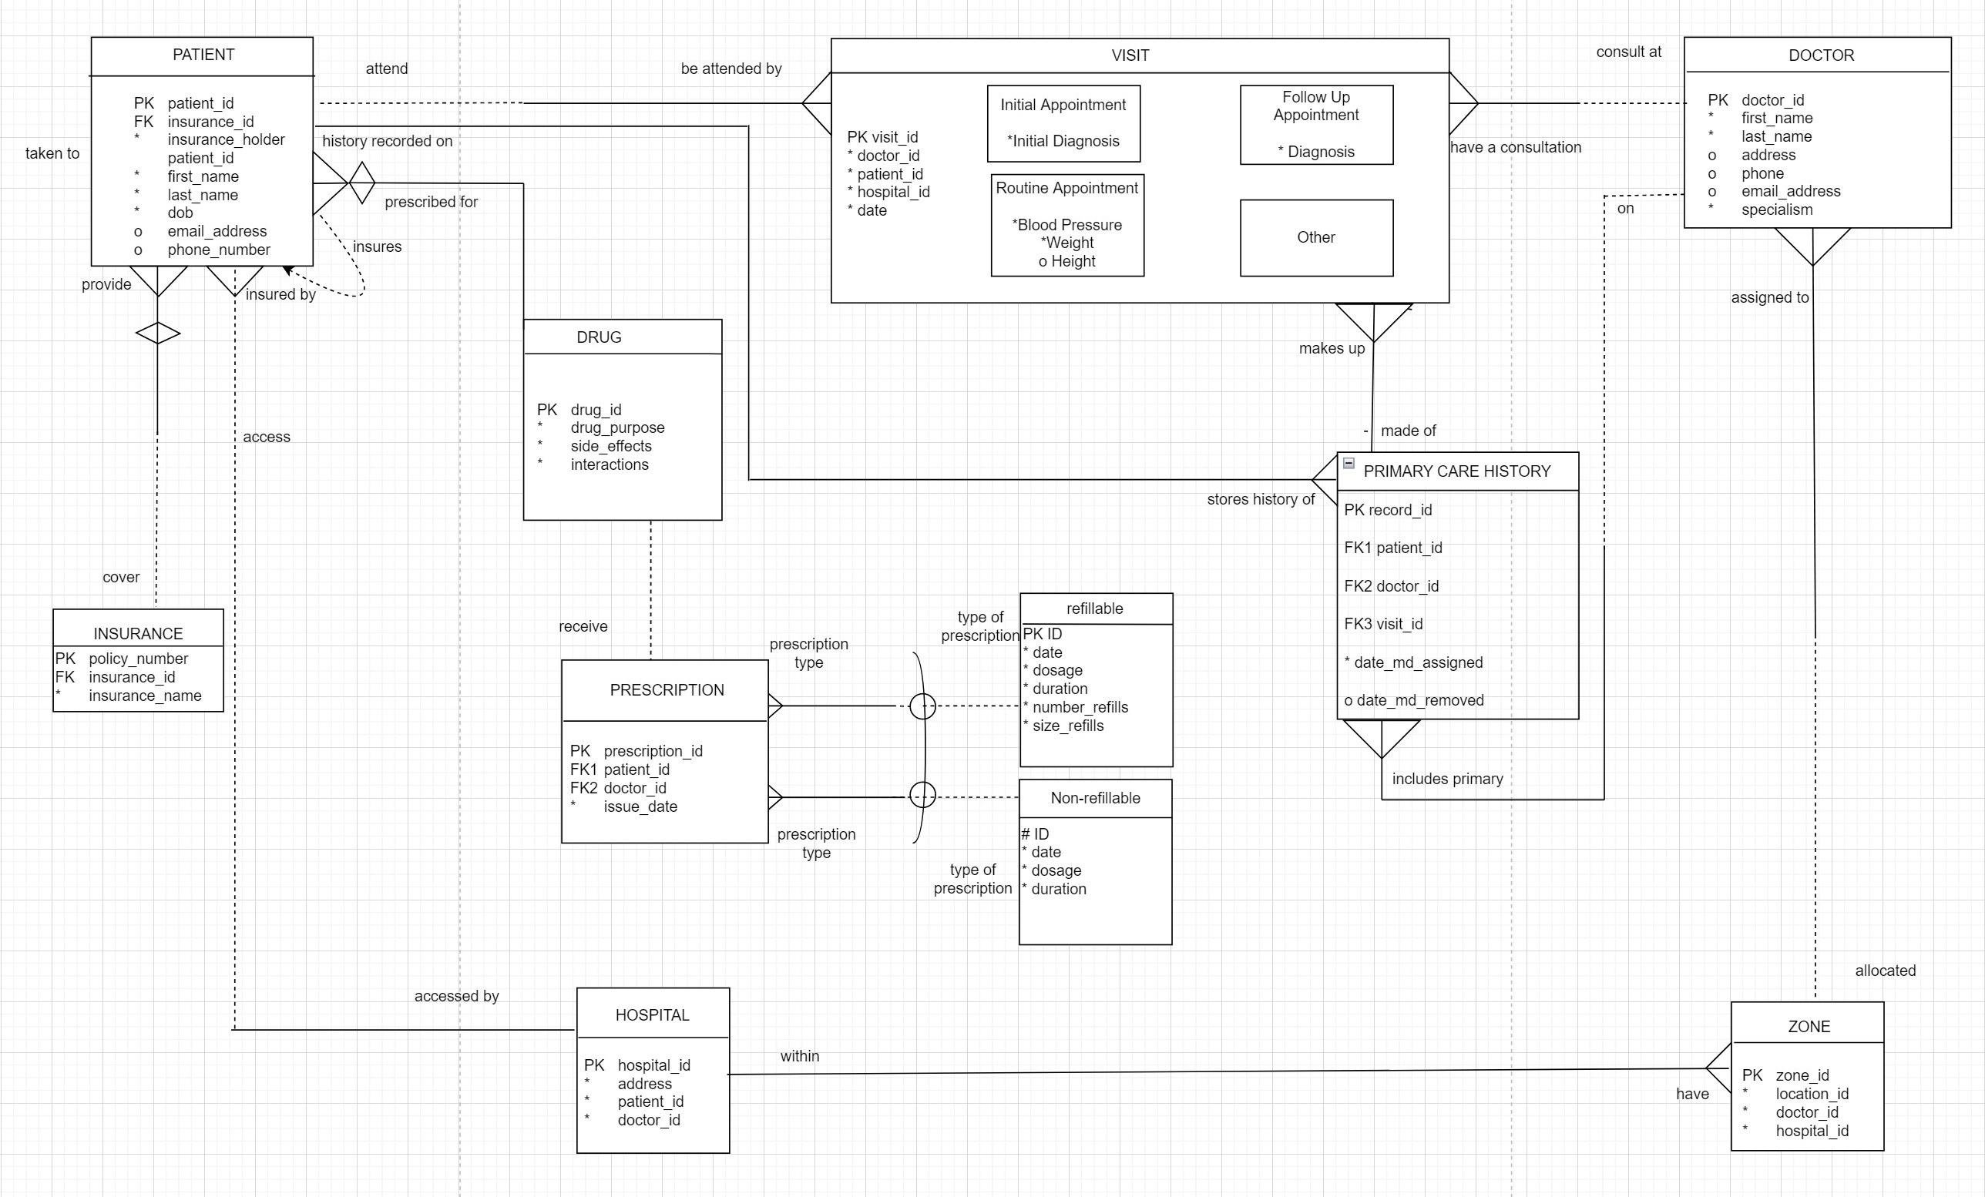
The ERD
T
H
E
E
RD

Slide 5
How are entities made?
To ensure that we have the best database system possible it is
necessary to break down all the information into many small blocks.
PATIENT
DOCTOR
PRESCRIPTION
HOSPITAL
J
H
I
These blocks are then broken down again until we have ensured that
all the information needed is recorded into the appropriate entities.
E
F
G
We do this to make sure the foundation of the database is strong
enough to hold the structure above it and keep it upright.
HealthOne
A
B
C
D
Medical
Database

Slide 6
Expanding upon our entities
We started off with 4 entities
PATIENT
DOCTOR
HOSPITAL
PRESCRIPTION
This was then increased to the existing 9 entities
VISIT
PRIMARY CARE HISTORY
INSURANCE
DRUG
ZONE
‘
Next information about each entity had the relevant information added to it along with a unique key

Slide 7
PK patient_id FK insurance_id * insurance_holder_patient_id * first_name * last_name * dob o email_address o phone_number
PK doctor_id * first_name * last_name o address o phone o email_address * specialism
PK hospital_id * address * patient_id * doctor_id
PK policy_number FK nsurance_id * insurance_name
PK prescription_id FK1 patient_id FK2 doctor_id * issue_date
INSURANCE
PATIENT
DOCTOR
HOSPITAL
PRESCRIPTION
PK visit_id * doctor_id * patient_id * hospital_id * date
PK record_id
FK2 doctor_id
FK3 visit_id
FK1 patient_id
date_md_assigned
o date_md_removed
PK drug_id * drug_purpose * side_effects * interactions
PK zone_id * location_id * doctor_id * hospital_id
VISIT
PRIMARY CARE HISTORY
DRUG
ZONE
The
The attributes for the entities were added

Slide 8
Connecting Entities
PATIENT
Primary Key
PK patient_id FK insurance_id * insurance_holder_patient_id * first_name * last_name * dob o email_address o phone_number
PK is the primary key
FK is the foreign key which indicates a link
Connections between the entities were established to better understand how each part worked together along with the impact that they had on each other
* Mandatory
o Optional
Foreign Key
INSURANCE
DRUG
HOSPITAL
PK policy_number FK insurance_id * insurance_name
PK drug_id * drug_purpose * side_effects * interactions
PK hospital_id * address * patient_id * doctor_id

Slide 9
INTERSECTION ENTITIES
The entity ZONE was made as an intersection entity to better represent the connection between the DOCTOR and the HOSPITAL.
DOCTOR
HOSPITAL
PK doctor_id * first_name * last_name o address o phone o email_address * specialism
PK hospital_id * address * patient_id * doctor_id
ZONE
PK zone_id * location_id * doctor_id * hospital_id

Slide 10
Visit as a Supertype with 4 Subtypes
The entity shown below has been subtyped. This means that all of the sub types have unique features independently of each other although they all share the VISIT attributes.
VISIT
Initial Appointment *Initial Diagnosis
Follow Up Appointment * Diagnosis
PK visit_id * doctor_id * patient_id * hospital_id * date
Routine Appointment * Blood Pressure * Weight o Height
Other
All of the information about the different visits are recorded under the one entity.

Slide 11
Relationship fundamentals
Types of relationships:
One to one
One to many
Recursive
Exclusive OR
Non-transferable
Mandatory
Utilised a variety of relationships to enhance readability.
Modelled under the assumption that client programs would avail of CRUD processes.
This practical approach allowed us to ensure usability of the final product.

Slide 12
UID’s and normalisation
First form normalisation:
Removes all multiple valued attributes from an entity.
UID (Unique Identifier) types:
Simple – a unique identifier consisting of a single attribute.
Composite – a unique identifier consisting of a combination of multiple attributes.
Artificial – these are UID’s specifically created for identifying specific.
Second form normalisation:
Removes any attribute which is not fully dependent on the entire primary key.
Third form normalisation:
Removes any attribute with dependences on any non-UID attributes.

Slide 13
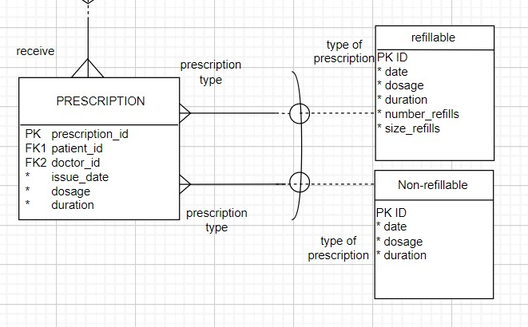
Arcs
What about different prescription types?
Mutually exclusive entities

Slide 14
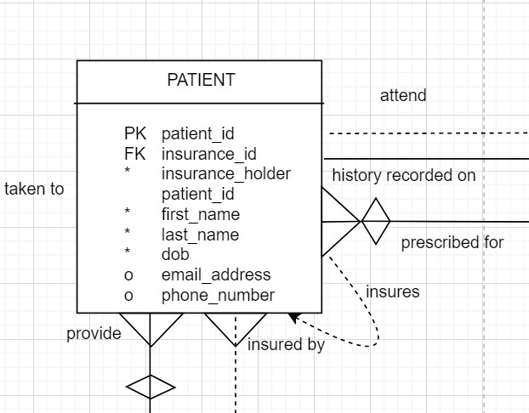
Recursive Relationships
Policy may include multiple family members
Need to show who is the policy holder
Adding insurance holder
Demonstrates if family member is insuring or being insured by.

Slide 15

Modelling Historical Patient Data

Slide 16

Client Requirement
Document changes to primary care provider (doctor) over time.
Why?
Performance measuring
Allows access to other relevant detail i.e. charts
Allows more general temporal modelling

Slide 17

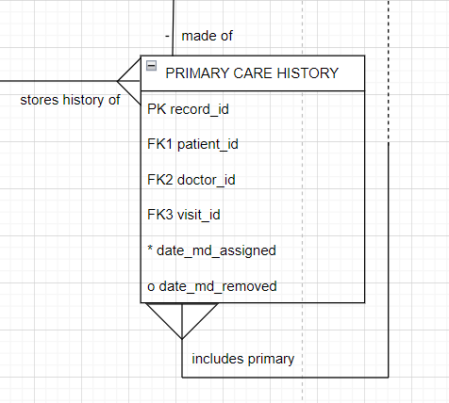
Our Solution
Intersection Entity vs Attribute

Slide 18
Our Solution
Intersection Entity vs Attribute
Attribute may violate third normal form.
Very likely to happen as analytics programs which use the database become more complex.
An intersection entity sidesteps this issue and offers a degree of “future proofing”.

Slide 19
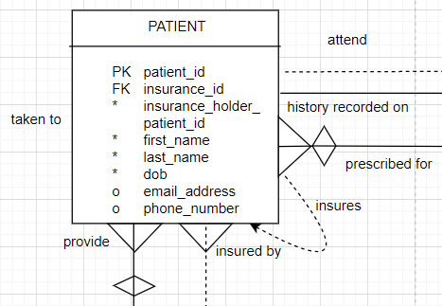
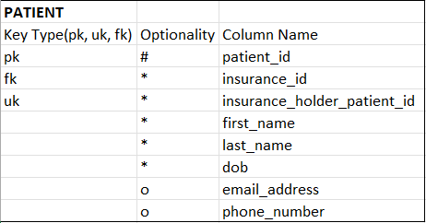
Basic Mapping
The structure chosen in respect of the ERD allows for direct implantation into a database format:
ERD Entity
Database Table

Slide 20

Documentation
Provided via email
Hard copy can be requested
Updated documentation will be provided with every new iteration of the database

Slide 21
Assumptions
Database will be need to be able to track trends
It will need to be easily translated into multiple languages
Will be iterated upon and updated along with changing business needs

Slide 22
In Closing
Any questions?
Thank you for your time

Slide 23

THANKS!
Do you have any further questions?
youremail@freepik.com
+91 620 421 838
yourcompany.com
Please keep this slide for attribution.

